Slide 1
Course Code:CSC402A Course Title: Web Architecture and Application Development
Course Leader:
Kishore S.M.
kishore.cs.et@msruas.ac.in

Slide 2
Objectives
After completing this lecture, the student will be able to
Analyze basics of Ajax

Slide 3
Contents
Ajax

Slide 4
Ajax
AJAX, is a web development technique for creating interactive web applications.
AJAX stands for Asynchronous JavaScript and XML. AJAX is a new technique for creating better, faster, and more interactive web applications with the help of XML, HTML, CSS, and Java Script
Ajax uses XHTML for content, CSS for presentation, along with Document Object Model and JavaScript for dynamic content display
With AJAX, when you hit submit, JavaScript will make a request to the server, interpret the results, and update the current screen

Slide 5
Ajax
AJAX is a web browser technology independent of web server software
A user can continue to use the application while the client program requests information from the server in the background

Slide 6
Ajax
AJAX cannot work independently. It is used in combination with other technologies to create interactive webpages.
JavaScript
Loosely typed scripting language
JavaScript function is called when an event occurs in a page.
Glue for the whole AJAX operation
DOM
API for accessing and manipulating structured documents
Represents the structure of XML and HTML documents
CSS
Allows for a clear separation of the presentation style from the content and may be changed programmatically by JavaScript

Slide 7
Ajax
All the available browsers cannot support AJAX. Here is a list of major browsers, that support AJAX
Mozilla Firefox 1.0 and above
Netscape version 7.1 and above
Apple Safari 1.2 and above
Microsoft Internet Explorer 5 and above
Konqueror
Opera 7.6 and above

Slide 8
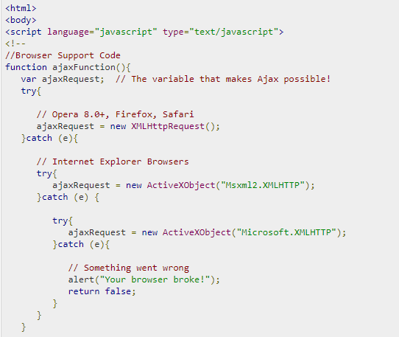
Ajax
Ajax database operations
Browser specific code

Slide 9
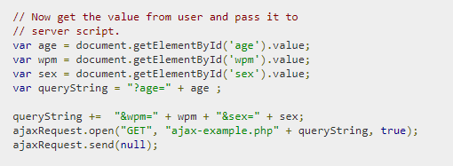
Ajax
Ajax database operations
Send Ajax get request to ajax-example.php file to add data into the server database.

Slide 10
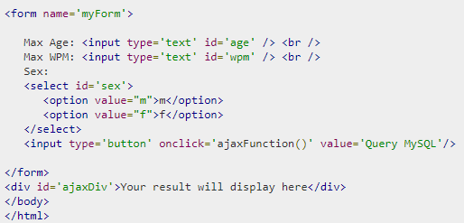
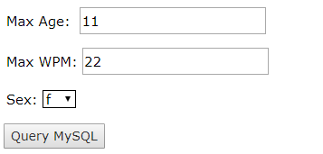
Ajax
Ajax database operations

Slide 11
Ajax
AJAX Security: Server Side
AJAX-based Web applications use the same server-side security schemes of regular Web applications
You specify authentication, authorization, and data protection requirements in your web.xml file (declarative) or in your program (programmatic)
AJAX-based Web applications are subject to the same security threats as regular Web applications

Slide 12
Ajax
AJAX Security: Client Side
JavaScript code is visible to a user/hacker. Hacker can use JavaScript code for inferring server-side weaknesses
JavaScript code is downloaded from the server and executed ("eval") at the client and can compromise the client by mal-intended code
Downloaded JavaScript code is constrained by the sand-box security model and can be relaxed for signed JavaScript

Slide 13
Ajax
AJAX issues
Complexity is increased
Server-side developers will need to understand that presentation logic will be required in the HTML client pages as well as in the server-side logic
Page developers must have JavaScript technology skills
AJAX-based applications can be difficult to debug, test, and maintain
JavaScript is hard to test - automatic testing is hard
Weak modularity in JavaScript
Lack of design patterns or best practice guidelines yet
Toolkits/Frameworks are not mature yet
Most of them are in beta phase

Slide 14
Summary
AJAX is a web browser technology independent of web server software

